Slide 1



New Arrivals AttENDANCE wORKSHOP
THURSDAY 15TH October 20226

Slide 2
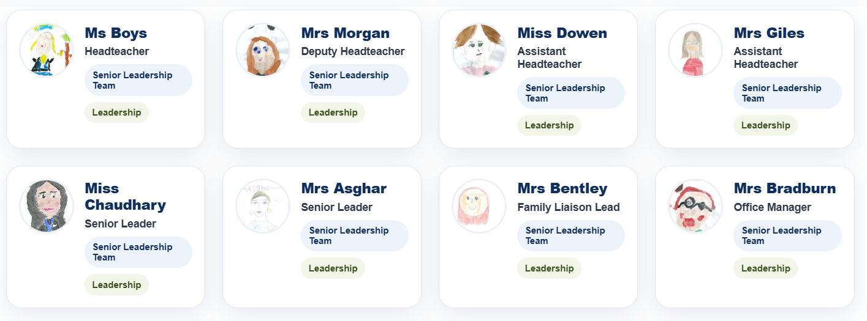
SENIOR LEADERSHIP TEAM

Slide 3
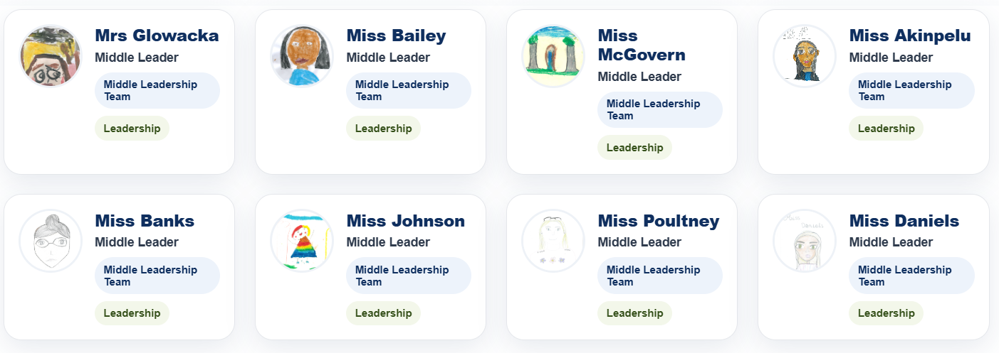
Middle leadership team/ year group leads

Slide 4
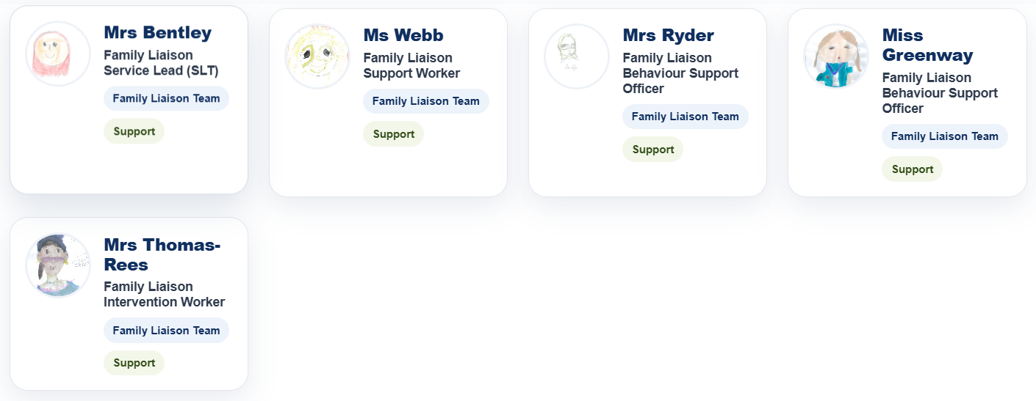
Family liaison team

Slide 5
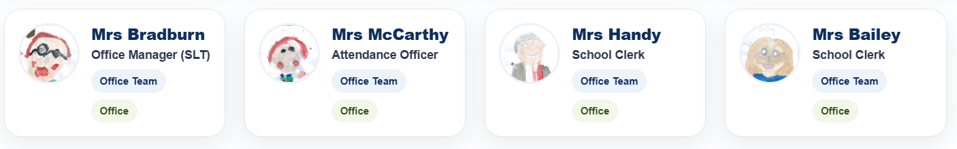
OFFICE STAFF

Slide 6
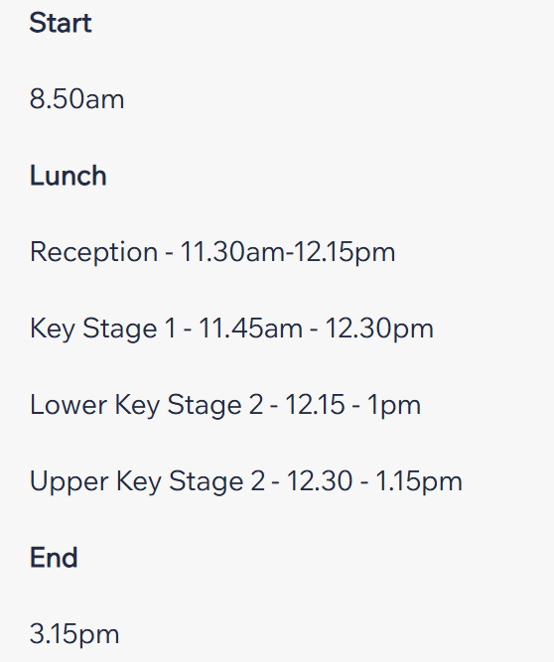
THE SCHOOL DAY

Slide 7

SCHOOL LUNCH and lunchtimes
Lunchtime Clubs & Activities
Lunch Bunch
Basketball
Roleplay
Football
Cross Country
Library
Chess
Scrabble
TT Rockstars

Slide 8
PE DAYS
EYFS - Monday + Forest School
Y1 - Thurs + Forest School
Y2 - Friday + Forest School
Y3 - Monday and Thurs
Y4 - Monday and Tues
Y5 - Tues and Weds
Y6 - Weds and Fri

Slide 9


SCHOOL APPS AND COMMUNICATION
Reporting an absence
After school clubs
Send messages to school
Update details
Add a guardian
Breakfast Club
Wraparound
School Trips
At home
Class story updates
See how many Dojos your children have
In School
Children are awarded Dojos linked to the NPPS
School Values (Be Kind. Be Brave. Be Proud)
- Certificates and prizes awarded

Slide 10
Reporting an absence
Reporting your child’s absence from school each morning is essential.
If your child is unable to attend school, please report their absence by 10:00am each morning using one of the following methods:
Arbor App – through the absence reporting facility
Telephone – call the school office on 01902 558715
Email – attend@northwoodparkprimary.co.uk
Please remember that an absence must be reported for each day your child is absent, unless you have already discussed the absence and its expected duration with a member of the Attendance Team.

Slide 11

Breakfast club and wraparound

Slide 12
Support for attendance
Attendance Team
Miss S Chaudhary – Attendance Lead
Mrs S McCarthy – Attendance Officer
Mrs K Webb – Family Liaison Attendance Support
Local Authority – Mrs H Wilkes (Education Welfare Officer)
We work closely with parents and carers to promote good attendance and ensure every child has the best possible start to their education. We provide clear guidance, regular communication and early support where attendance begins to cause concern, working in partnership with families to understand and address any barriers to attendance. Our approach is supportive, non-judgemental and focused on helping children attend school regularly and thrive.

Slide 13


NPPS ATTENDANCE REWARDS

Slide 14

School rewards

Slide 15
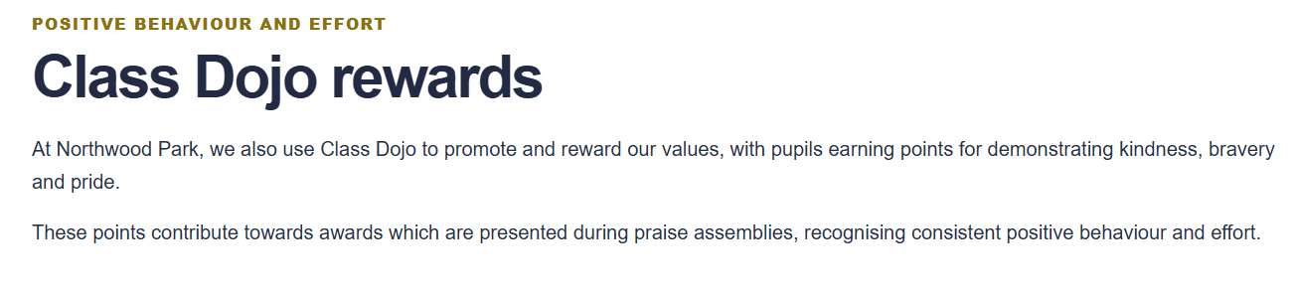

School rewards

Slide 16

Working together

